Slide 1
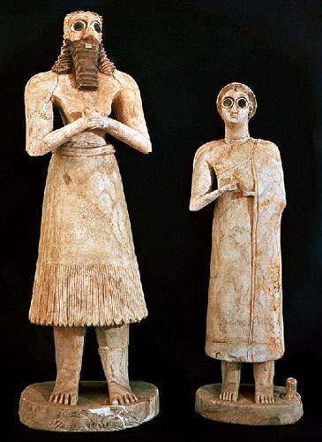
WHN – WP Entry (World History Notebook – Writing Prompt Entry
Imagine you are an anthropologist who is interpreting these statues. What might these statues tell us about the history of the Sumerian people?
Mesopotamian Statue

