Slide 1
Ancient Egypt:
The Nile Valley…
and other physical features of Egypt
World History I
Mrs. Bailey

Slide 2
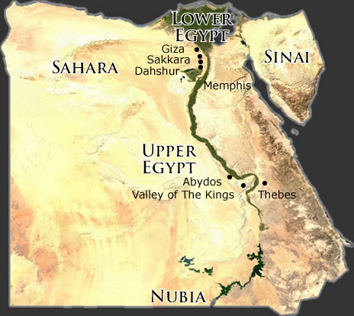
Things to Know and Items to Add to Map
Upper and Lower Egypt
Nile is the longest river in the world
Nile River Animation
Notes:
On your Nile and Mesopotamia regional Map…
Western Desert (Sahara)
Eastern Desert
First and Second Cataracts
Nile Delta
Upper Egypt
Lower Egypt

Slide 3
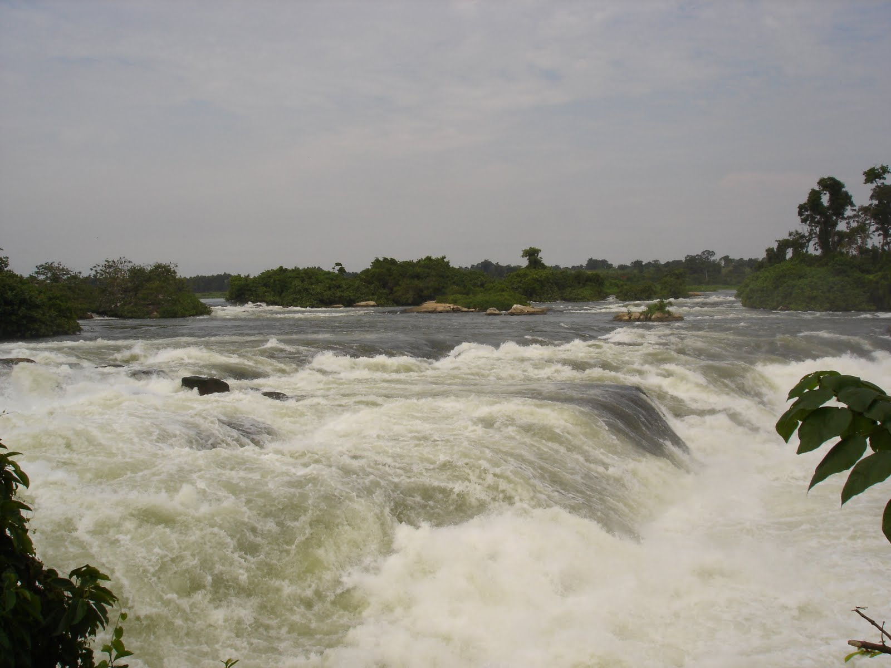
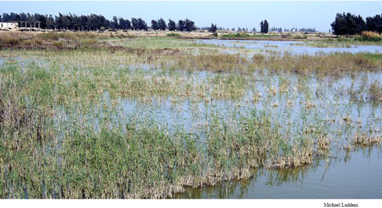
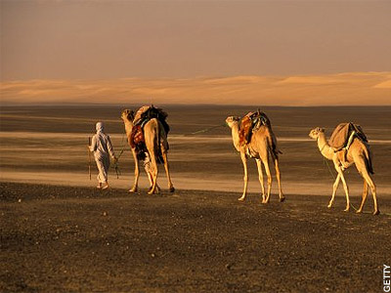

Review what you read/watched
What are Egyptians Natural Barriers?
  Deserts
  Cataracts in the Nile
  Delta marshes
Discuss:
How did each natural barrier work to protect Egypt from outside invasion?

Slide 4
WHN
How did the geography of the Nile River lead to the growth of civilization there?
  Natural barriers for protection
  Enriched soil for farming
  Rivers and seas for trade
Nile River - Animated Map

Slide 5
Egyptian Irrigation
Dig Basins (bowl-shaped holes) to trap floodwaters
Farmers dig canals to carry water from basins to fields
Build dikes (earthen banks) to strengthen basin walls
Farmers use a shadoof to get water from the river to the basins
Irrigation and Shaduf

Slide 6
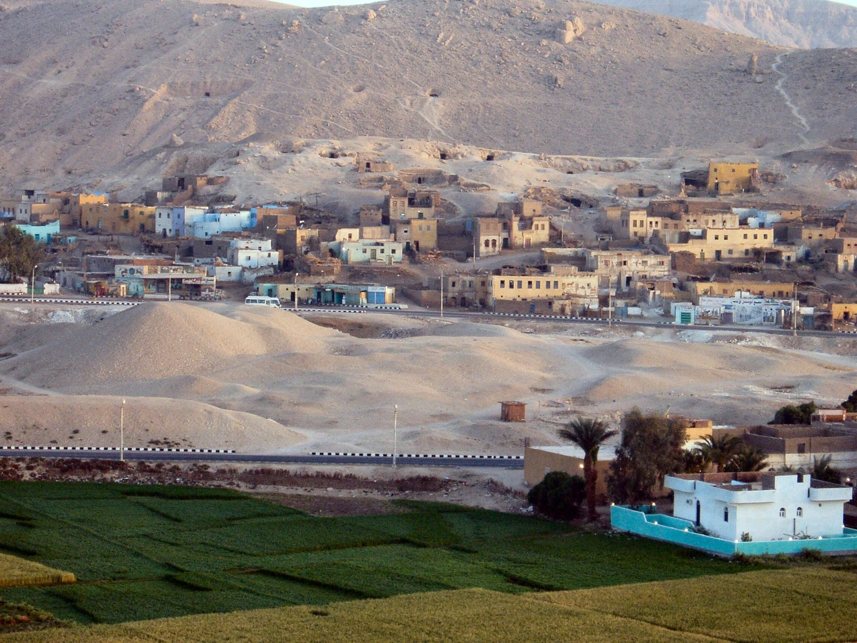
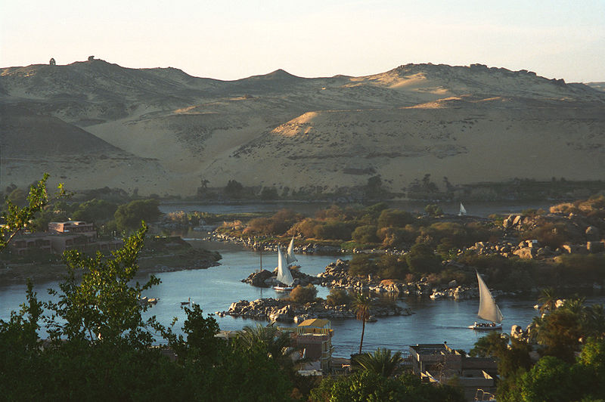
Why is most farming in ancient Egypt and in present-day Egypt done along the Nile?
  The Nile enriches and waters the soil while the rest of the area is desert.

Slide 7
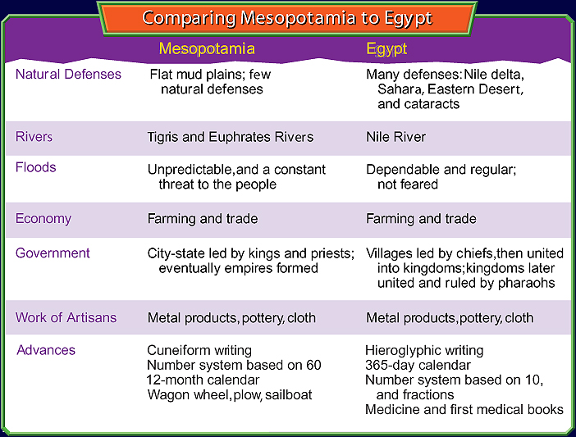
MESOPOTAMIA
EGYPT
Medicine and first medical books
Number system based on 10
Nile River
Many natural defenses
Predictable flooding, not feared
Villages with chiefs
Empires with pharaohs
Wheel, plow, sailboat
City-states with kings and priests
Unpredictable, threatening flooding
Tigris and Euphrates Rivers
Empires
Few natural defenses
Farmers
Traders
River Civilizations
Artisans are same
Writing System
Number System
Calendar System

Slide 8
Walk Like an Egyptian

