Slide 1
WHN – Writing Prompt
Write at least 4 sentences.
What would life be like if there were no laws or rules?

Slide 2
Mesopotamia “The Land Between the Rivers” Sumer and Assyria flourished here
Mesopotamia: From Nomads to Farmers
World History I
Mrs. Bailey

Slide 3
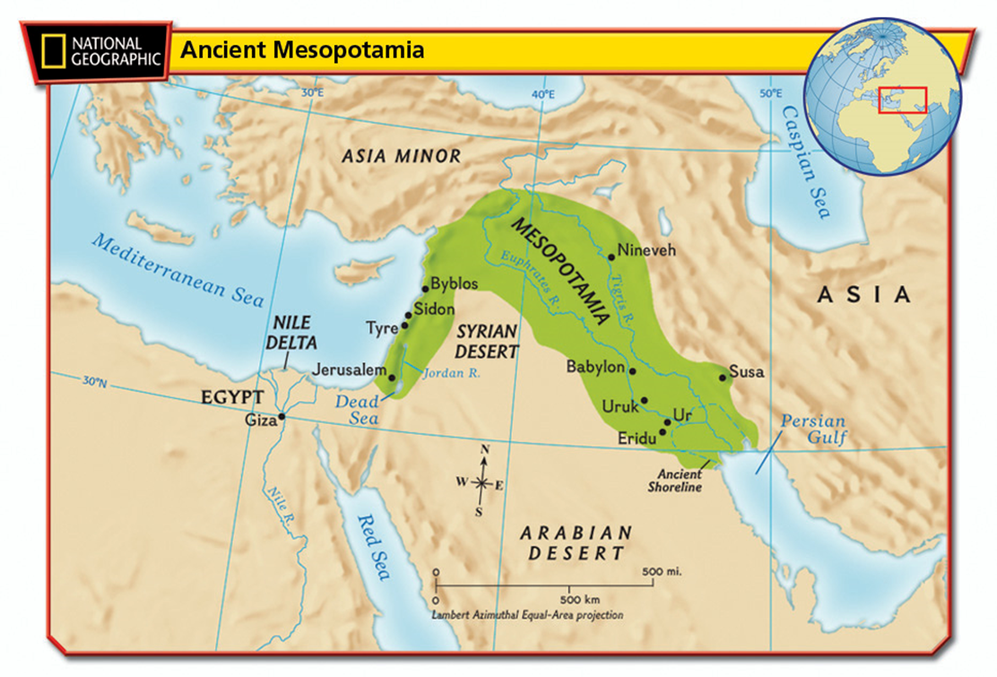

Slide 4
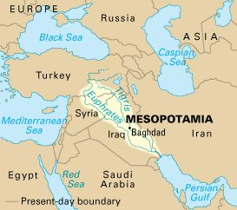
Notes:
Located between the Tigris and Euphrates Rivers. Both rivers begin in the mountains of Eastern Turkey. The rivers are each over 1,000 miles in length. Mesopotamia was located in the modern day countries of Turkey, Syria, and Iraq. People first started farming here around 5000 B.C. and they began irrigating their fields from the rivers.
http://www.hawaii.edu/ahead/Iraq%20General/mesopotamia.jpg

Slide 5
Why is Mesopotamia Important?
Known as “cradle of civilization” – new ideas
Influence left lasting impact on the ancient world
Sumer/Sumerians – Earliest known civilization

Slide 6
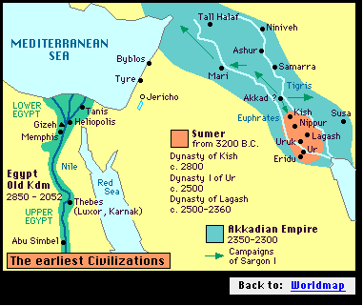
Mesopotamia Interactive Map
Notes:
http://www.stutzfamily.com/mrstutz/Maps/ancient/sumer.gif

Slide 7
Sumerians Zigguarat Image -- Mesopotamia -- National Geographic
Control physical environment
control flooding of Tigris and Euphrates rivers
built levees and canals for crop irrigation
Took planning and cooperation organization
government
laws
cities
The Rise of Farming Communities
Notes:
Around 4000 B.C. the first towns were built, which had walls, mud-brick houses and temples.
By around 3500 B.C. the Sumerians created the first civilization, which was ruled by a government structure known as a city-state. Sumerians created the concept of a king that gained powers from the heavens. The king or “priest-king” was the one who would speak with the gods, lead the people in war, and run the city-stated during times of peace. Major cities include Ur, Kish, Uruk, and Babylon. Each city-state ruled itself, had it’s own gods/goddesses and king or priest king, and built walled cities as the city-states often went to war with one another.
They grew wheat, barley, dates, and other vegetables. They raised cattle, donkeys, sheep, and goats.

Slide 8
Mesopotamian Contributions
Writing - Cuneiform
Wheel
Wooden Plow (wheat, barley, dates, vegetables)
Sailboat
Number system based on 60
First written legal code – Hammurabi’s Code
Early Clay Tablet

Slide 9
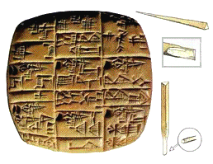
CUNEIFORM
Notes:
The wrote on clay tablets to record trade activities.
http://www.artlex.com/ArtLex/m/mesopotamian.html

Slide 10
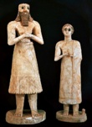
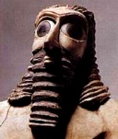
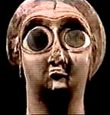
“The statues found at the Abu Temple in Tell Asmar from c. 2700 BCE are fine examples of the way Sumerian sculpture is typically based on cones and cylinders — arms and legs like pipes, skirts smooth and round, flaring out at their bottoms. Faces are dominated by very large eyes; but, for reasons we might take for granted, artists of many cultures have placed emphasis on eyes. The sizes of entire figures were also determined by a hieratic imaging system — the most important people were made the tallest. In the same vein, a beard on a figure signified a man in a powerful position.”
Ancient Pull Toy
Notes:
http://www.artlex.com/ArtLex/m/mesopotamian.html

Slide 11
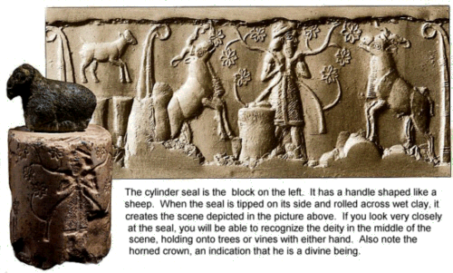
The Sumerians used cylinder seals carved out of stone as identification. In order to identify themselves, a Sumerian would roll his cylinder seal across a wet clay tablet making an imprint, which when baked by the sun or through a kiln, would become permanent. Think of it as an ancient signature!
Notes:
http://www.nlcs.k12.in.us/oljrhi/brown/mesopotamia/meso.htm

Slide 12
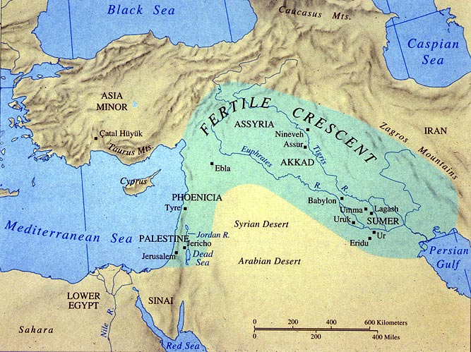
Notes:
http://www.utexas.edu/courses/classicalarch/images2/mapane.jpg

Slide 13
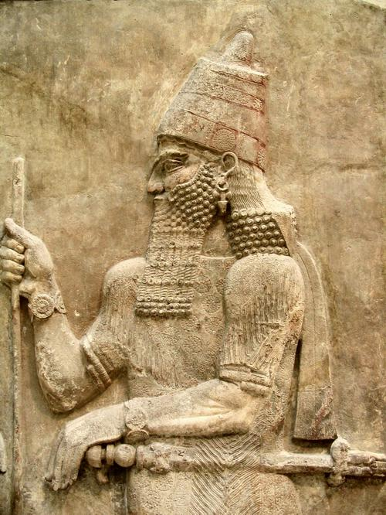
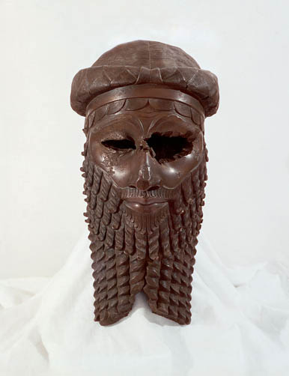
Sargon
Ruler of Kish
C. 2300 B.C. – 2100 B.C.
Conquered Sumerian cities
Created world’s first empire
C. 2100 – Ur controlled Sumer

Slide 14
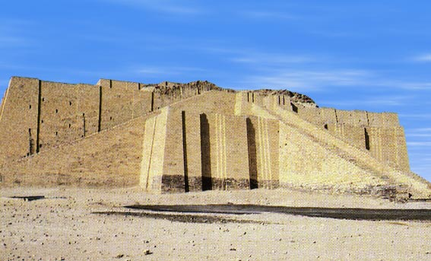
“Ur was the principal center of worship of the Sumerian moon god Nanna and of his Babylonian equivalent Sin. The massive and impressive ziggurat of this deity, one of the best preserved in Iraq, and one of the most famous historical monuments in the World, stands about 21 m above the desert.”
Notes:
http://www.atlastours.net/iraq/ur.html

Slide 15
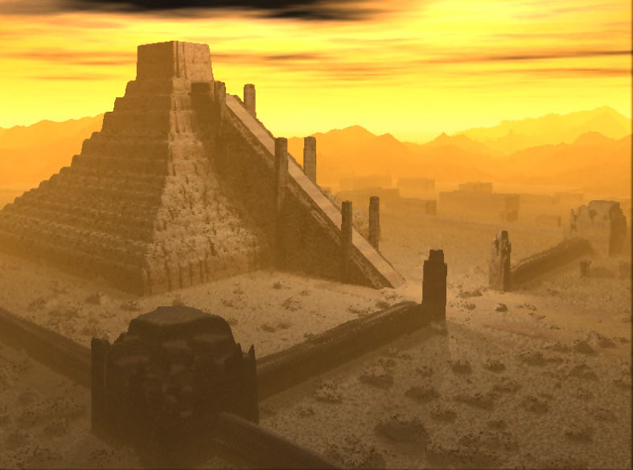
Notes:
http://www.iranian.com/History/2005/March/Gutians/Images/gutians_sumer_ziggurat1a.jpg

Slide 16
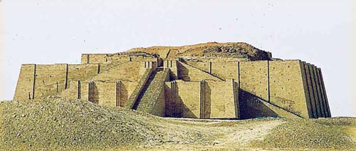
Explore and Learn More About Ziggurats
Notes:
http://www.d.umn.edu/cla/faculty/troufs/anth1602/images/Turn81706_Ur1.jpg

Slide 17
King Hammurabi and His Laws From the Peace Resource Center
The Code of Hammurabi - c. 1750 B.CE.
Ruler of Babylonia (one of several rival Mesopotamian kingdoms)
His reign marked a golden age of Semitic culture
Conquered other Mesopotamian kingdoms
Issued a law code to “establish justice throughout Mesopotamia”
Clay tablet records – scrupulous, able administrator
Law code influenced civilizations for centuries
Dealt with trade, labor, property, family, slavery
“eye for an eye, tooth for a tooth”
Stone column discovered in Iran in 1901 (now in Paris)
Notes:
http://www1.umn.edu/humanrts/peace/peaceedu/binder2.html

Slide 18
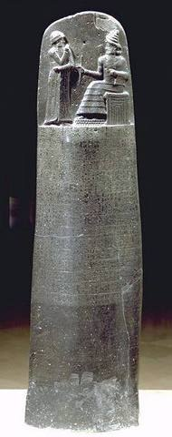
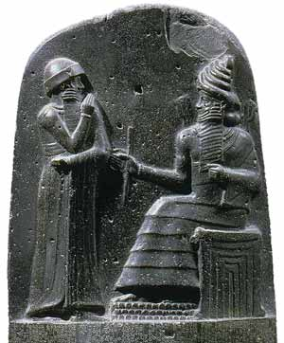
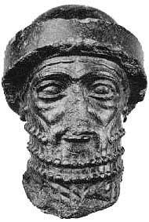
Hammurabi’s Code of Laws
Hammurabi Interactive
Ruler of Babylonia
c. 1792 B.C.
Notes:
King Hammurabi received the code from the Babylonian Sun God Shamash. The 282 laws, while not the only code used in Mesopotamia, were the only ones etched into stone thus earning them the distinction of being the first known written code of law. The code is based on retribution, not justice and is not administered equally among the social classes.

Slide 20
Stop – Read - Think – Discuss How has Hammurabi’s Code influenced our society today?
The first extensive set of laws written down
Established clearly defined punishments and penalties
The law applies to all people within the empire (universal appeal)
Established rules and regulations for all walks of life
Gives people certain rights!
Gives people justice, decides who is right and who is wrong!
Establishes Ethics: What is appropriate behavior

Slide 21
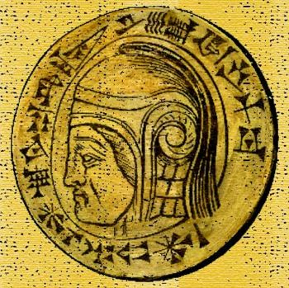
Nebuchadnezzar II
C. 625-600 B.C.
Babylonia regained control of Mesopotamia from Assyrians
Rebuilt Babylon into a magnificent city

Slide 22
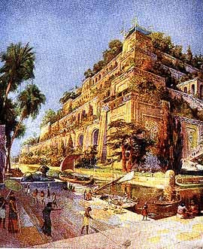
Notes:
The Hanging Gardens of Bablyon were built by King Nebuchadnezzar II in the sixth century BCE. He ruled for 43 years and is said to have built them for Amyitis, his wife. Amyitis came from Medes where the land was very mountainous and green while Mesopotamia was flat and received lots of sun. The Hanging Gardens, really just overhanging from the balconies, were an “artificial mountain with rooftop gardens. Strabo, a Greek geographer, wrote in the first century:
It consists of vaulted terraces raised one above another, and resting upon cubic pillars. These are hollow and filled with earth to allow trees of the largest size to be planted. The pillars, the vaults, and terraces are constructed of baked brick and asphalt. The ascent to the highest story is by stairs, and at their side are water engines, by means of which persons, appointed expressly for the purpose, are continually employed in raising water from the Euphrates into the garden.
http://www.shelwin.com/Babylon%20Lane/Hanging%20Gardens%20of%20Babylon.jpeg

Slide 23
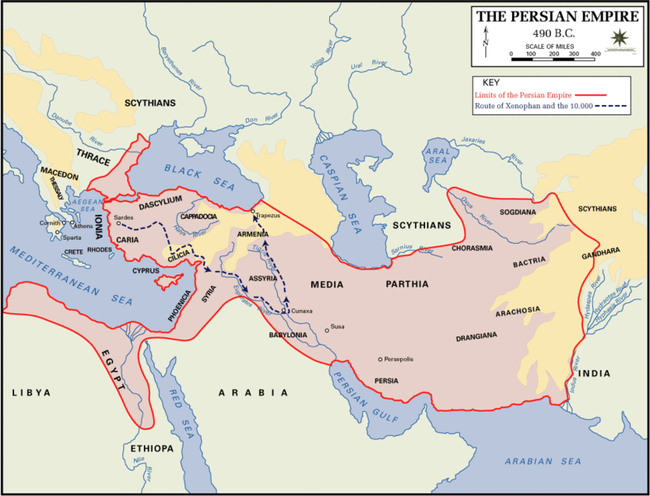
C. 539 B.C.
Persians conquered Babylonia

Slide 24
C. 331 B.C. - Alexander the Great captures Babylon
Babylon falls into ruins after his death (c. 323 B.C.)

Slide 25
Summary Reasons Mesopotamia Is Important
New Ideas
Who can provide an example we’ve discussed?
Why do you think their influence left a lasting impact on the ancient world?
What is considered the earliest known civilization?
Collapse: Mesopotamia

