Slide 1
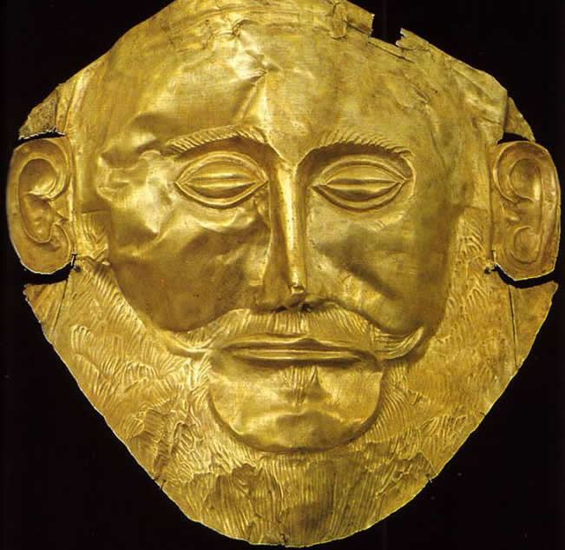
Imagine you are an archaeologist who discovered this mask.
Think about and be ready to discuss what it tells you about the civilization it belongs to?
WHN WP:
Mask of Agamemnon
Write at least two questions you have or would ask if you were an archaeologist or a historian.
Describe at least one item you would want in your tomb.

