Slide 1
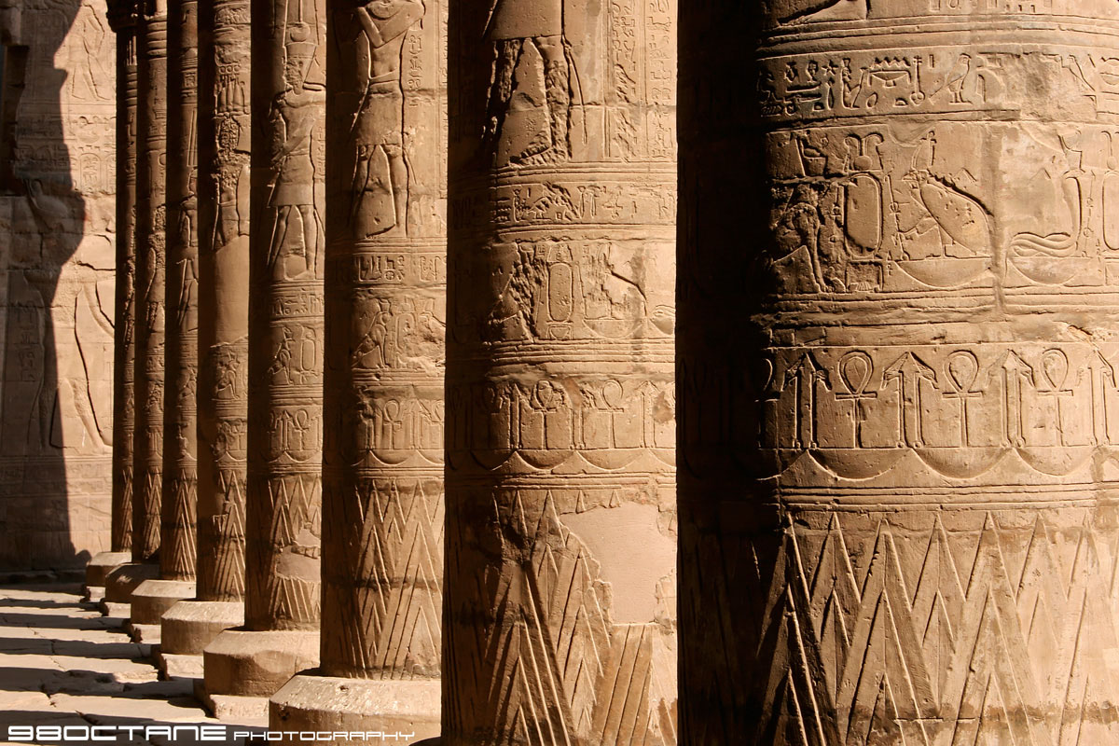
Hieroglyphics

Slide 2
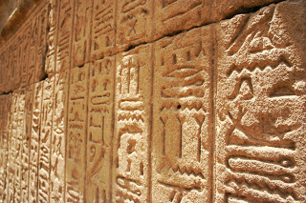
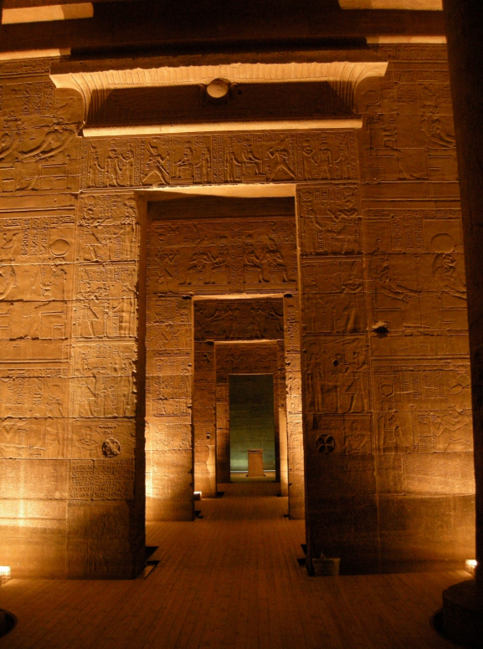
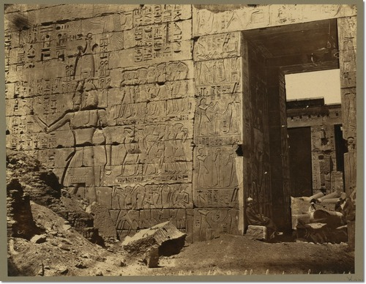
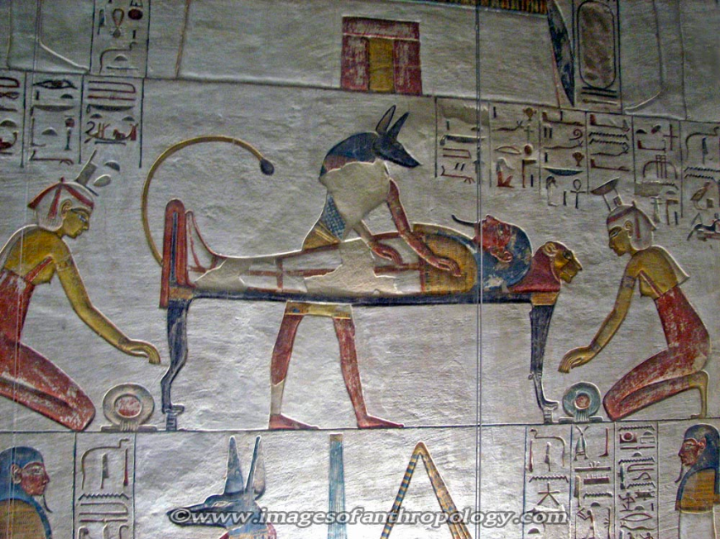

Slide 3
Key to Decoding Hieroglyphics
In 1799, French soldiers found a stone fragment in Rosetta, Egypt.
Soldiers of Napoleon Bonaparte
Enlarging a fort
In 1801 the English defeated the French and the stone and other artifacts became property of England.
Exhibited in the British Museum since1802

Slide 4
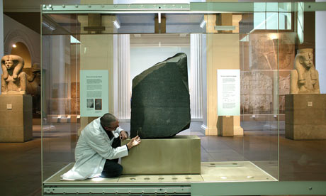
Size
3 ft. 9 in. × 2 ft. 4½ in. × 11 in
1,676 lbs
That’s about 1.5 Polar Bears

Slide 5
Hieroglyphics
(Language of the Priests)
Demotic
(Everyday language)
Greek
(Administration language - family of the king was originally Greek)

Slide 6
What was the stone for?
Carved in 196 B.C.
Pharaoh Ptolemy V
King’s official announcement of gifts he had given to the Temple
Make Connections: Why was it written in three languages?

Slide 7
Whereas King Ptolemy, living forever, the Manifest God whose excellence is fine, son of King Ptolemy [and Queen] Arsinoe, the Father-loving Gods, is wont to do many favours for the temples of Egypt and for all those who are subject to his kingship, he being a god, the son of a god and a goddess, and being like Horus son of Isis and Osiris, who protects his father Osiris, and his heart being beneficent concerning the gods, since he has given much money and much grain to the temples of Egypt, [he having undertaken great expenses] in order to create peace in Egypt and to establish the temples, and having rewarded all the forces that are subject to his rulership; and of the revenues and taxes that were in force in Egypt he had reduced some or(?) had renounced them completely, in order to cause the army and all the other people to be prosperous in his time as [king

Slide 8
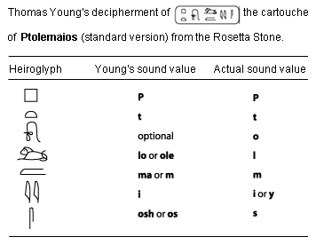
Translation
Thomas Young guessed that the hieroglyphics with lines around them were probably more significant than the rest and might spell out the ruler’s name.
Today we call them Cartouches
However, Young claimed that the name was only spelt out phonetically because it was foreign. So his work stopped.

Slide 9
Translation
In 1822 a French scholar Jean Francois Champollion continued Young’s work.
He was able to translate another cartouche.
Ramses –
He was able to show that it was a phonetic alphabet and went on to translate the Rosetta Stone
Later went to Egypt and began translating some of the monuments there

Slide 10
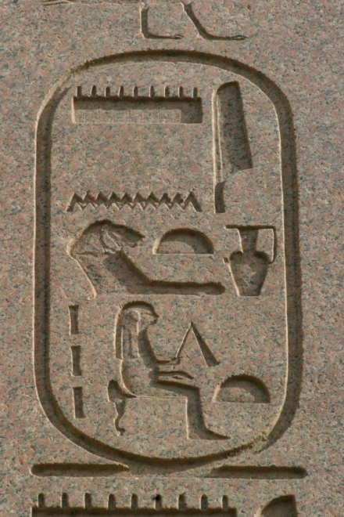
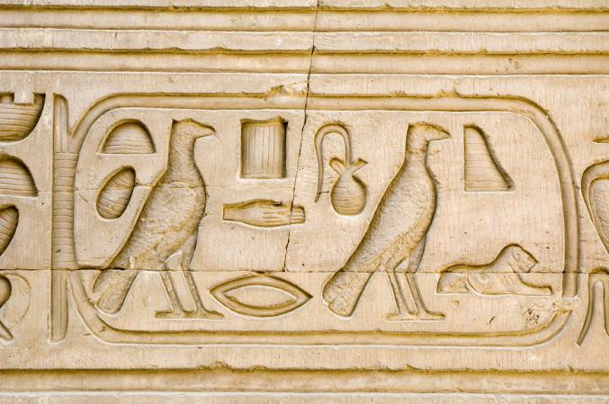
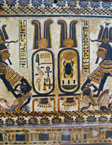
Cartouches
Cleopatra
Hatshepsut
Tutankhamen

