Slide 1
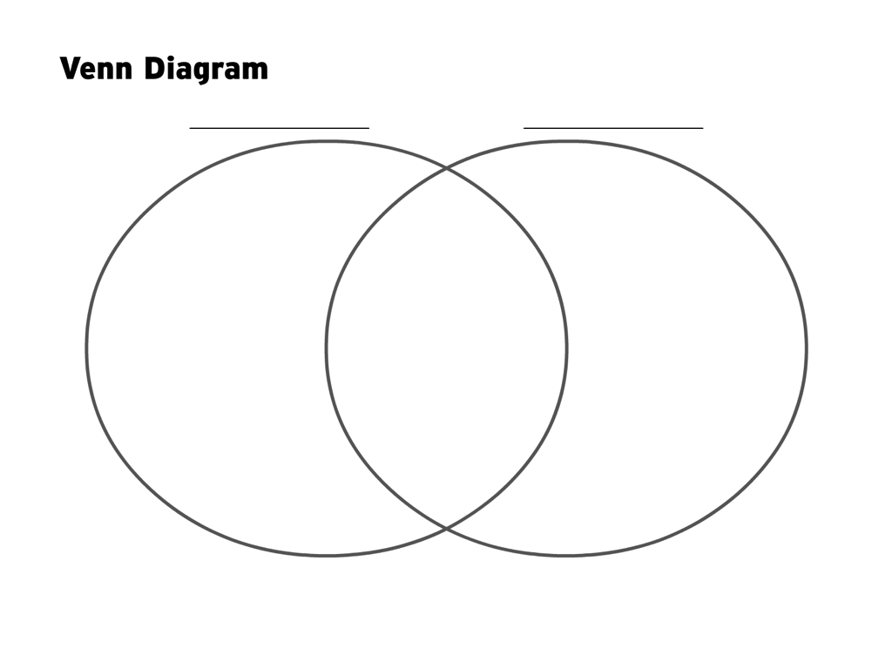
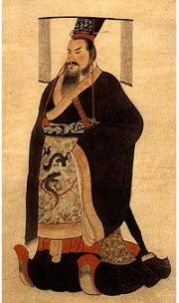
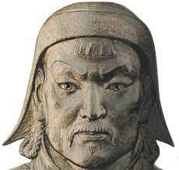
/25 points total
Prompt:
Compare: Genghis Khan (of Mongolia) to Emperor Qin Shihuangdi (of China).
Similarities? Differences? While we watch a 30 min clip; complete the following Venn diagram
YouTube Clip: (First 30 mins only) https://www.youtube.com/watch?v=fQ53WqklIo8

Slide 2
Now … Which of these leaders would you argue was the greatest and why? Explain your thoughts in a solid paragraph below.

