Slide 1
Chaldeans vs. Assyrians Station Activity
Instructions: Write down ideas between The Chaldeans and Assyrians and similarities using the Venn diagrams below and using the different stations to understand Chaldeans and Assyrians. Each station will have one Venn diagram.
Station 2: Accomplishments
Station 1: Warfare

Slide 2
Station 3: Daily Life
Station 4: Fun Facts

Slide 3
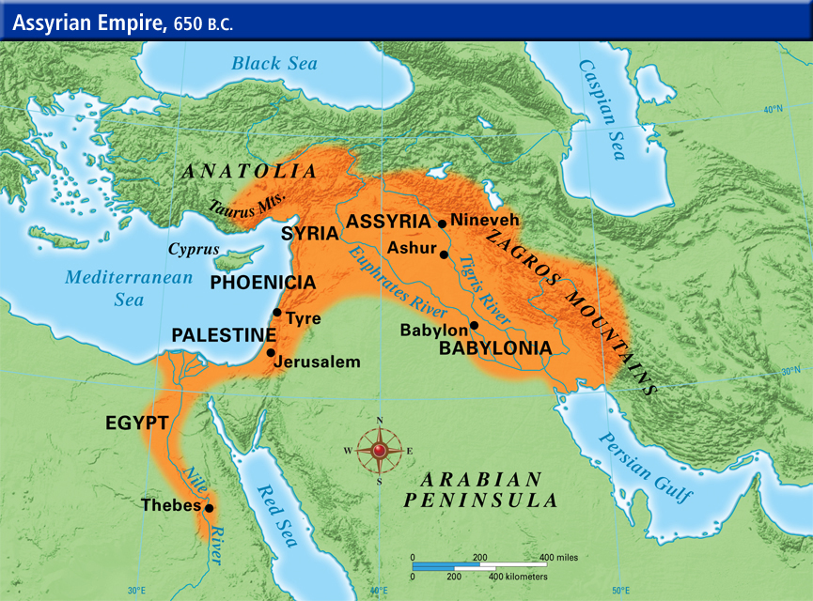
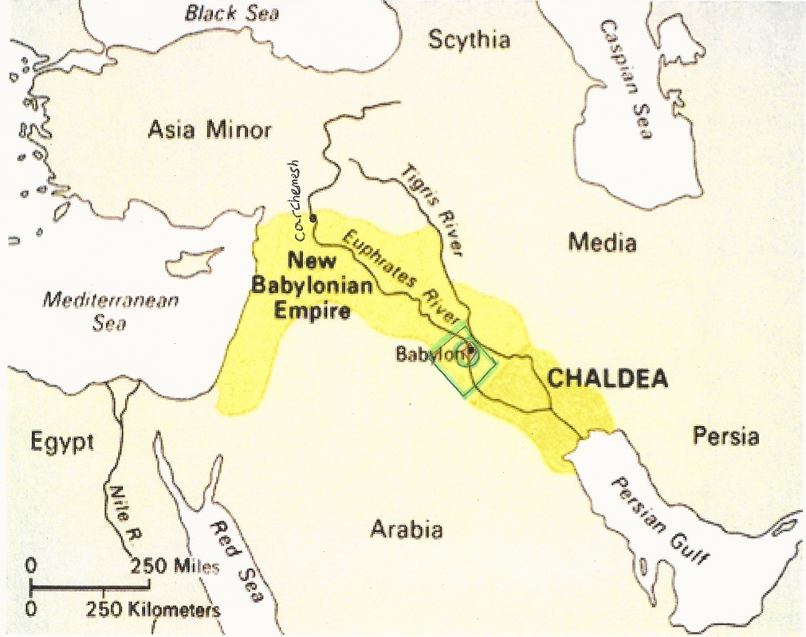
Station One: Warfare
Both the Chaldeans and Assyrians had armies to protect their kingdom, but their ways of doing so differed. The Assyrian Empire ruled Mesopotamia for such a long time, partly because of their well-organized army. At the forefront, groups of soldiers armed with daggers and spears stood strong. The other parts of the army consisted of expert archers, chariot riders, and men who fought on horseback. Another factor that lead to the Assyrian Empire’s longevity was their use of iron weapons. Iron had been used in the making of tools for centuries, but at the time iron was too soft to be considered a material for weapons. A group of people called the Hittites, who lived northwest of Assyria, developed a method to make iron stronger. The Hittites taught the Assyrians to heat iron ore, hammer it into the desired shape, and rapidly cool it. This method allowed the Assyrians to create weapons stronger than the copper and tin weapons carried by their enemies. When attacking cities, the Assyrians would tunnel under walls, or climb ladders over walls. Once a city or village was captured, the goods and people of the fallen city would be taken away. The Assyrian’s treatment of captured cities was extremely brutal compared to other empires.
The Chaldeans were able to gain power in Mesopotamia after they defeated the Assyrian Empire. In 626 B.C. under King Nabopolassar’s rule, The Chaldeans began forcing the Assyrians out of Mesopotamia. About twenty years later he died, and his son Nebuchadnezzar became the ruler of the Chaldeans. From 605 B.C. to 562 B.C. the Chaldeans had control over all of Mesopotamia. The Chaldean military was significant enough to capture several cities and regions, such as Carchemish and Ashkelton, but their military power was less well known than that of the Assyrians. The Chaldean Empire tried to overtake Egypt many times, all without success, but following the last attack in 567 B.C., the Egyptians stopped attacking Chaldean territory. After all of Mesopotamia was under Chaldean rule, the Chaldeans focused more on defending their territory, rather than obtaining new territory. By 539 B.C. the Chaldean’s were having a hard time controlling the people they conquered and their army was unable to defeat the Persians. Perhaps the Chaldean army was not as dominant as the Assyrian army, but the Chaldean people found success in other areas.

Slide 4
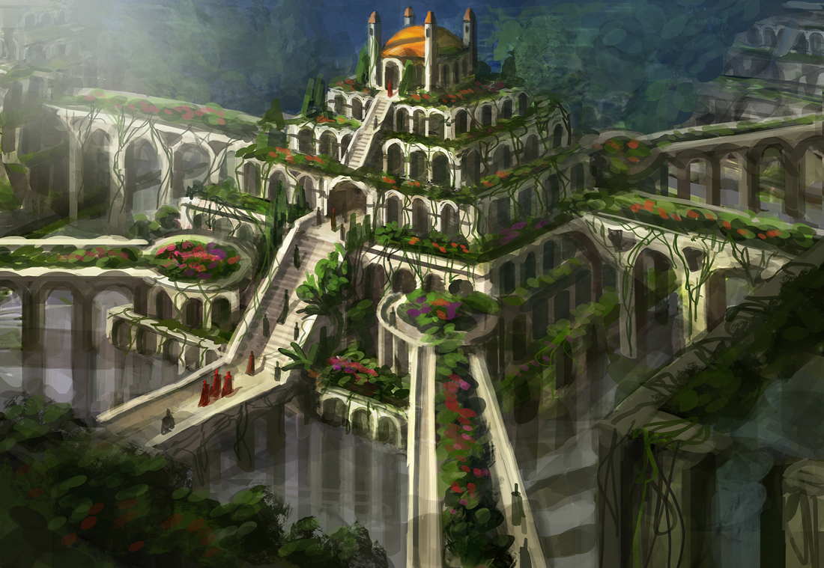
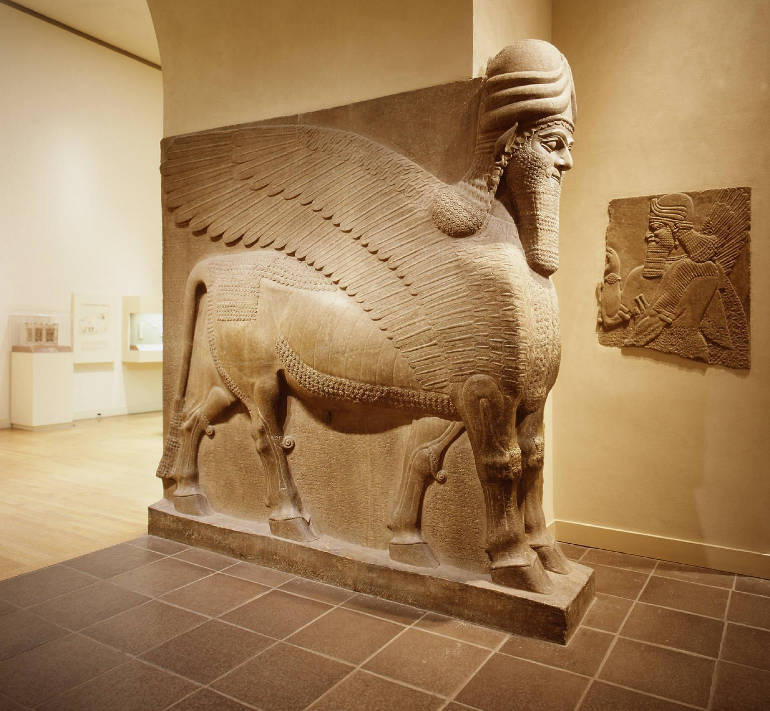
Station 2: Accomplishments
The Chaldean and Assyrian Empires are two of the most well known groups to ever rule Mesopotamia, and these empires were able to accomplish many different things during their reign. The Assyrian Empire existed from 900 B.C. until about 612 B.C. In this time, they were able to develop an extremely well organized army and government. By 650 B.C. their empire stretched from the Persian Gulf in the east to the Nile River in the west. The Assyrians built a large capital named Nineveh, which was on the Tigris River. The massive size of the Assyrian Empire determined that the land should be divided into sections called provinces. Another name for these provinces is political districts, and each of these districts were governed by officials chosen by the King. Assyrian builders created large temples and palaces, and within them were various wall carvings and statues. Furthermore, the capital of Assyria, Nineveh, was home to one of the first libraries in the world, which contained 25,000 tablets of stories and songs for the gods. In fact, much of what is known about the Assyrian Empire was discovered from this library.
Despite the fact that the Chaldean’s rule over Mesopotamia was much shorter than that of the Assyrians, Chaldea made very notable accomplishments. The Chaldeans rebuilt the city of Babylon on the Euphrates river, and named it their capital. Babylon quickly became known as the largest and richest city in the world. The city of Babylon was surrounded by a wall so large that two chariots were able to pass by each other using a road on top of the wall. Along with the large walls, the city of Babylon was home to a massive ziggurat that towered over 300 feet above the ground. Additionally, the city of Babylon contained a beautiful green pyramid known as the Hanging Gardens. These gardens made of trees, flowering vines, and other plants were visible from anywhere in the city. A water pump brought water to the Hanging Gardens from a nearby river. Various canals ran through the city of Babylon, which gave the citizens water. Due to the emphasis put on astronomy, the Chaldean empire was also considered the center of science. Along with all of these accomplishments, the Chaldeans were one of the first people to create a sundial, and they were to first to have a seven-day week.

Slide 5
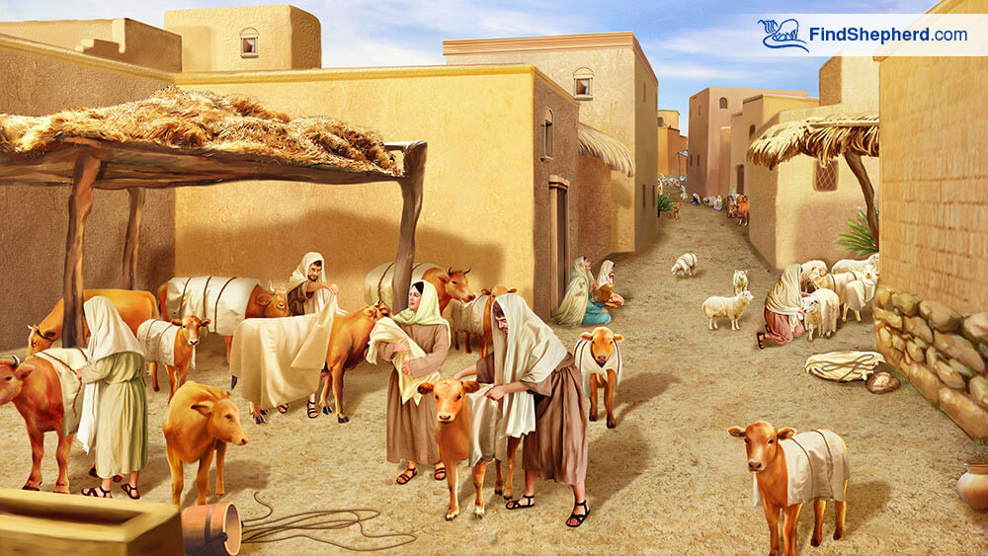
Station 3: Daily Life
For historians, daily life is one of the most difficult things to research. The lack of records describing how average people lived in Mesopotamia between 900 B.C. and 500 B.C. makes it difficult for historians to piece it together. However, several different conclusions can be drawn based on the artifacts found by archeologists. The Assyrians lived very similarly to other Mesopotamians. Assyrian writing was based on Babylonian writing, many of the same gods were worshipped, and the laws were similar. However, In Assyria, lawbreakers often received much harsher punishments than other Mesopotamians. Additionally, historians have described the people of Assyria as rather poor compared to other empires, such as the Chaldean Empire. Many people of Assyria were skilled builders, which was necessary to create so many palaces and buildings. The existence of one of the first libraries in the world suggests that many of the people of Assyria were relatively well educated. Eventually, the cruel treatment of people led to Assyria’s demise. Rebellions began breaking out towards the end of the Empire’s existence, which allowed the Chaldean Empire to rise.
During the Chaldean Empire’s reign, several palaces and temples made up the city center. The existence of all of these large structures also suggests the Chaldeans were very skilled builders. Outside the city center, there were marketplaces and houses, and this is where artisans were able to create pottery, cloth, baskets, and jewelry. The artisans were able to sell their creations to passing caravans and traveling merchants. Babylon was located on the major trade route between the Persian Gulf and the Mediterranean Sea, so much of the economy was based on trade. Trade and high taxes were two of the main contributors for the immense amount of wealth held by the Chaldeans. According to historians, the Chaldeans adopted many of the same laws as the Assyrians. The people of Chaldea, much like other people of Mesopotamia, including Assyrians, believed that changes in the sky revealed plans of gods. Some people in the Empire were astronomers who studied the sky, mapped the stars and kept track of the phases of the moon. Despite success in the field of science, Chaldean literacy was less developed compared that of the Assyrians.

Slide 6
Fun Facts:
Assyrians:
The Assyrians controlled Mesopotamia from 900 B.C. to about 612 B.C. for a total of 288 years
The Assyrians successfully stopped the Chaldeans from rebelling several times, but in 612 B.C. they were unable to control them, which is why the Assyrian empire crumbled.
Before modern archaeology techniques, the bible was the main source of information about Assyria, which described it as having “irresistible military might.”
Assyrian art is generally associated with massive winged bulls and lions. Statues of these mythical animals also guarded many entrances to the Assyrian palaces.
Fun Fact Question: Assyrians divided their territory into provinces, or political boundaries, can you compare this to how the US is divided today?
Chaldeans:
The Chaldeans gained a huge area of land in a rather short amount of time; interestingly this is the reason the empire fell. They were unable to control such a large area.
Most of the Chaldeans were descendants of the people who made up Hammurabi’s empire 1,200 years earlier.
The Hanging Gardens of Babylon were considered one of the Seven Wonders of the Ancient World, but some historians doubt they ever even existed. What is thought to be the Ruins of the Hanging Gardens has been found, but the theory is not universally accepted.
Chaldean astronomers made great discoveries and named many constellations, but only a few of their discoveries have survived today, in the form of clay tablets.
Eventually, the Greeks adopted Babylonian astronomy, and furthered the development of it.
Fun Fact Question: Do you think the Hanging Gardens existed or are they a myth? Why?

