Slide 1
Before you start … Answer the question on your handout!
Brainstorm: In your opinion, describe characteristics, traits, ethics, or aspects that makes a good leader.

Slide 2
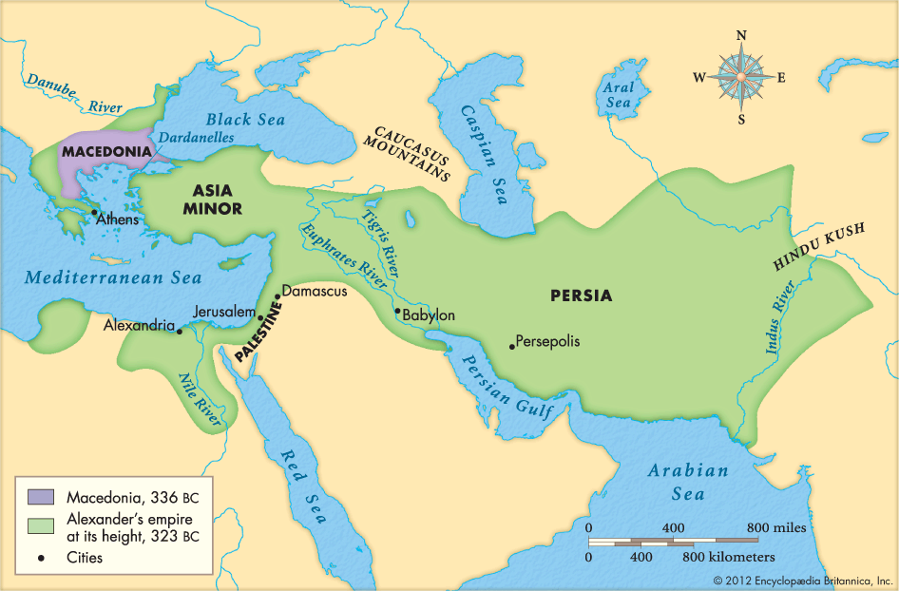
When Alexander Took over as King in 336BC
When Alexander Dies

Slide 3
Additional Key points on Alexander
At 13 he became the pupil of Aristotle.
Became King at 20 and Died at 32
He married one of Darius’ daughters - Roxanna - and “encouraged” 10,000 of his soldiers to take Persian wives
Embraced Eastern Culture and spread Greek culture – Created Library and Schools everywhere
Embraced other gods and goddess
Fought and won every battle but wanted to go home
Became very paranoid and had drinking problem
His Barber said …

Slide 4
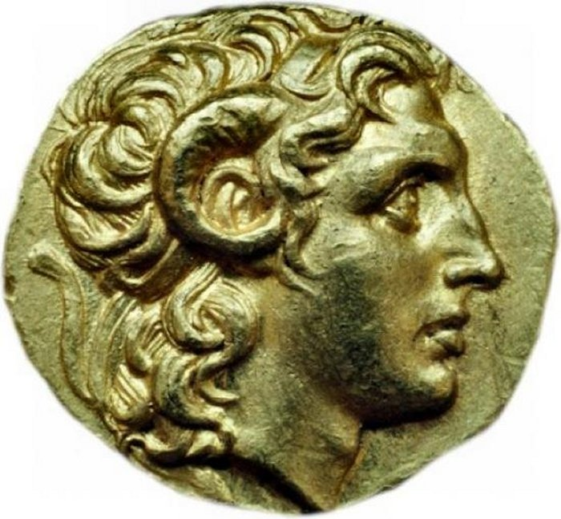
On ancient Greek coins Alexander the Great was portrayed with two horns. An ancient legend from Syria tells that Alexander the Great had horns on his head. An Ethiopic variation of the story refers to Alexander as man with “the two horns”.
Greek, minted in Ephesus, Asia Minor
Tetradrachm (Coin) Portraying Alexander the Great, 306/281 BC, issued by King Lysimachus of Thrace
http://www.ancientpages.com/2015/11/07/enigma-people-gods-horns-ancient-times/

Slide 5
Death
They embalmed him and placed his body in a gold sarcophagus which was taken to Memphis, Egypt. Later it was transported to it's final destination, Alexandria. Unfortunately, the tomb was not left untouched. In 89 B.C., Ptolemy IX needed money, so he opened the tomb and melted down Alexander's sarcophagus to make gold coins. People were so enraged that Ptolemy would do such a thing to a legend, that Ptolemy was killed soon after.

Slide 6
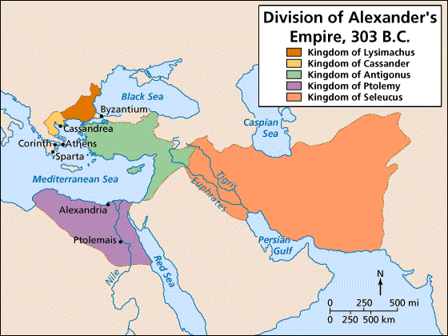
The Breakup of Alexander’s Empire
Alexander never had an heir (a child to take his thrown) so his empire on his death bed was divide by his generals.

Slide 7
Now that you are done
Answer the final question!
Overall impressions: Is Alexander a great or not so great leader? Explain
Alexander - Station Four
At this station read either page 180 or page 181 as a group and all together complete one sheet in the packet.
If you are an Opposer … Read page 180
If you are a Supporter … Read page 181
Be ready to share your write-up with the class. You SHOULD use all other notes on Alexander to complete this write-up to ensure you have the best argument in the class!

